Slide 1
CSS Layout
(grid and flex)

Slide 2
Flexbox
The flexible box model is a one dimensional layout model that provides a method to offer special distribution and powerful alignment capabilities
Responsive and mobile friendly
Orders of elements can be changed easily
Flexbox model works by using container and item properties
Flex container is an element that contains flex items
Flex items are direct children of flex containers

Slide 3
Flexbox properties
The Flexbox module includes properties for parent elements, (flex containers), and child elements (flex items)
The flex container properties include:
flex-direction, flex-wrap, flex-flow, justify-content, align-items, align-content
The flex items properties include:
order, flex-grow, flex-shrink, flex-basis, flex, align-self

Slide 4
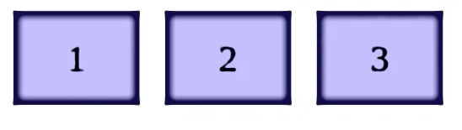
Flex container
The first step to start using Flexbox is to create a flex container.
This is done by setting the display property to flex on the parent element.
As a result, it becomes a flex container with its direct children (be they divs, list items, paragraphs, etc.) automatically becoming flex items.
For example:
HTML CODE
<div class="container"> <div>1</div> <div>2</div> <div>3</div> </div>
CSS CODE
.container { display: flex; }
Notes:
The default arrangement after applying display: flex is for the items to be arranged along the main axis from left to right.

Slide 5
Flex-direction (flex container property)
This establishes the main-axis, thus defining the direction flex items are placed in the flex container.
Flexbox is a single-direction layout concept. I.e., flex items are primarily laid out either in horizontal rows or vertical columns.
flex-direction
Values: row | column | row-reverse | column-reverse
Default: row
Applies to: flex containers
Inherits: no
Notes:
Values: are the accepted values for the property. Could be Predefined keyword values
Default: This is the value that will be used for the property by default, that is, if no other value is specified.
Applies to: Some properties apply only to certain types of elements, such as block or table elements.
Inherits: This indicates that the child element will naturally inherit a CSS property with its value from the parent element if the CSS property is not specified

Slide 6
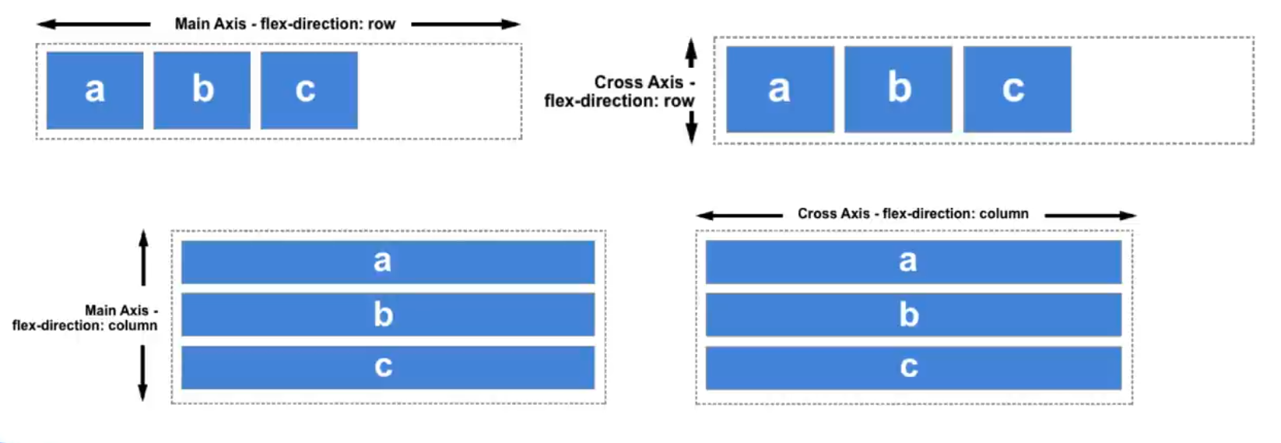
Axes in flexbox layout model
.

Slide 7
Axes in flexbox layout model
The property values within the flexbox system do not reference "left," "right," "top," or "bottom." Instead, the main axis and the cross axis are used.
The main axis is the flex direction specified for the flex container.
When set to row, the main axis is horizontal;
when set to column, the main axis is vertical.
The cross axis is perpendicular to the main axis (vertical for row, horizontal for column).

Slide 8
Flex-wrap (flex container property)
By default, flex items will all try to fit onto one line.
We can change that and allow them to break onto additional lines as needed using flex-wrap property.
The ‘wrap’ keyword turns on the ability to wrap onto multiple lines
flex-wrap
Values: nowrap | wrap | wrap-reverse
Default: nowrap
Applies to: flex containers
Inherits: no

Slide 9
Flex-flow (flex container property)
This is a shorthand for the flex-direction and flex-wrap properties, which together define the flex container’s main and cross axes.
flex-flow
Values: flex-direction flex-wrap
Default: row nowrap
Applies to: flex containers
Inherits: no

Slide 10
Alignment of Flex Items in the Container
The following container properties affect the alignment of items along the main axis and cross axis.
Container properties for aligning on the main axis
justify-content
Container properties for aligning on the cross axis
align-items
align-content

Slide 11
justify-content (flex container property)
By default, flex items are only as wide as they need to be, i.e., the flex-container may have space to spare on the flex line.
Also by default, the items flow in right next to each other from the starting position of the main axis
This property defines how extra space should be distributed around or between items that have reached their maximum size
Values: flex-start | flex-end | center | space-between | space-around
Default: flex-start
Applies to: flex containers
Inherits: no
Notes:
space-between: first item is on the start line, last item on the end line; and the remaining space is distributed evenly between the remaining items
space-around: adds an equal amount of space on the left and right side of each item, resulting in a doubling up of space between neighboring items.

Slide 12
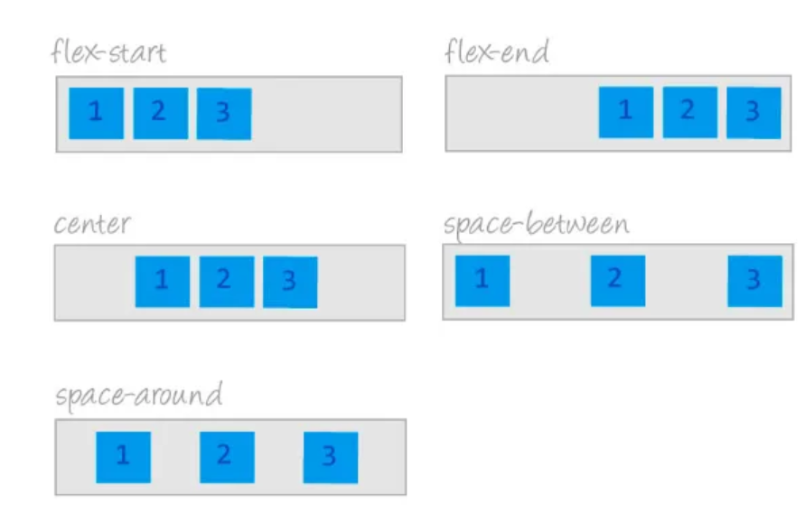
justify-content

Slide 13
align-items (flex container property)
This defines the default behavior for how flex items are laid out along the cross axis on the current line.
It’s like the justify-content version for the cross-axis.
align-items
Values: flex-start | flex-end | center | baseline | stretch
Default: stretch
Applies to: flex containers
Inherits: no
Notes:
The baseline value aligns the baselines of the first lines of text, regardless of their size. It may be a good option for lining up elements with different text sizes, such as headlines and paragraphs across multiple items.

Slide 14
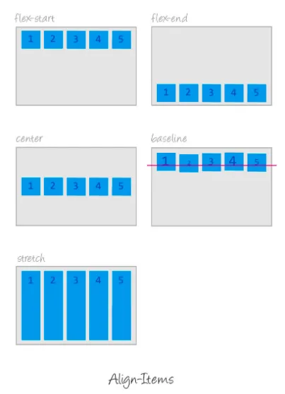
align-items
Notes:
Like justify-content, the align-items property applies to the flex container

Slide 15
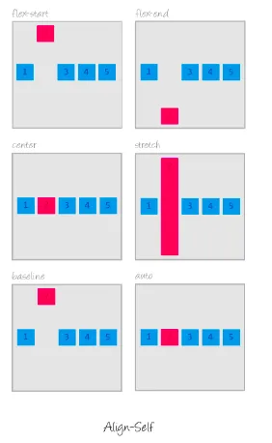
align-self
This allows the default alignment (or the one specified by align-items) to be overridden for individual flex items.
align-self
Values: flex-start | flex-end | center | baseline | stretch
Default: stretch
Applies to: flex items
Inherits: no

Slide 16
align-content (flex container property)
align-content, affects how multiple flex lines are spread out across the cross axis.
align-content applies only when there are multiple wrapped flex lines.
If the flex items are on a single line, it does nothing.
align-content
Values: flex-start | flex-end | center | space-around | space-between | stretch
Default: stretch
Applies to: multi-line flex containers
Inherits: no

Slide 17
flex-grow (flex item property)
This defines the ability for a flex item to grow if necessary.
It accepts a unitless value that serves as a proportion.
It dictates what amount of the available space inside the flex container the item should take up.
If flex-grow value for all flex items is set to 1, the browser takes whatever extra space is available along the main axis and applies it equally to each item, allowing them all to stretch the same amount.
Values: number
Default: 0
Applies to: flex items
Inherits: no

Slide 18
flex-shrink (flex item property)
This defines the ability for a flex item to shrink if necessary. Such as when the container is not wide enough to contain the items.
This property takes away some space from within the items, shrinking them to fit, according to a specified ratio.
flex-shrink
Values: number
Default: 1
Applies to: flex items
Inherits: no

Slide 19
flex-basis (flex item property)
This property defines the starting size of the item before any wrapping, growing, or shrinking occurs.
It may be used instead of the width property (or height property for columns) for flex items.
flex-basis
Values: length | percentage | auto
Default: auto
Applies to: flex items
Inherits: no

Slide 20
Flex
Flex is controlled with the flex property, which specifies how much an item can grow and shrink, and identifies its starting size.
flex is a shorthand property for flex-grow, flex-shrink, and flex-basis. Typically listed in this order:
flex: flex-grow flex-shrink flex-basis;
Eg., flex: 1 0 200px;
flex
Values: none | 'flex-grow flex-shrink flex-basis'
Default: 0 1 auto
Applies to: flex items
Inherits: no

Slide 21
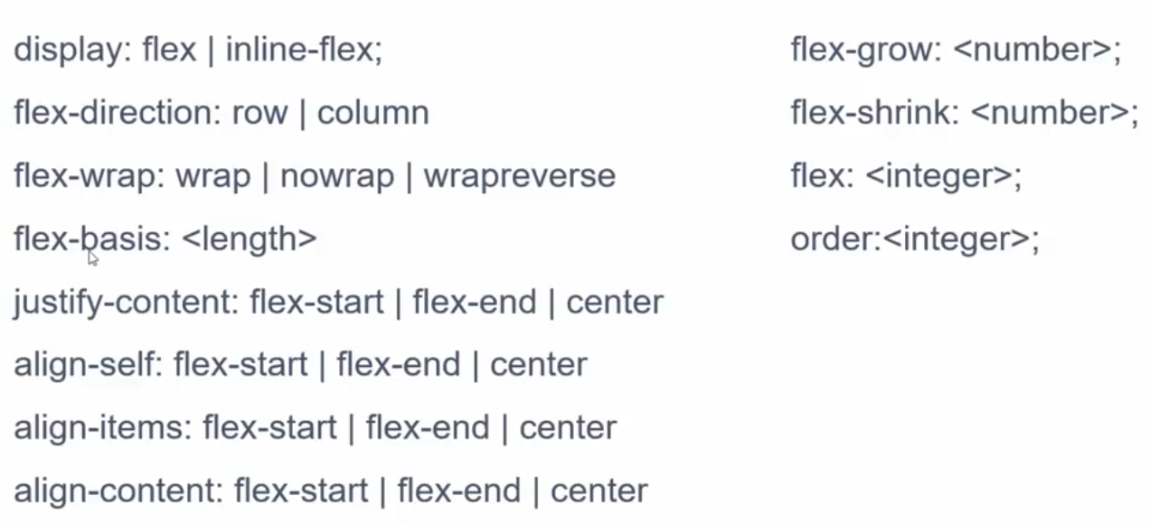
List of all flex container and Item properties

Slide 22
Icebreaker questions
___________ provides file location of an image to use as background
___________ specifies underlines, over lines and line-through
___________ specifies the location of the origin background image
___________ specifies whether and how a background image repeats
___________ changes the capitalization of text
___________ specifies transparency level of elements.
___________ specifies a typeface of a text
___________ specifies the level of boldness of a font

Slide 23
Icebreaker questions
___background-image____ provides location of an image to use as background
____text-decoration_______ specifies underlines, over lines and line-through
_background-position___ specifies the location of the origin background image
__background-repeat__ specifies whether and how a background image repeats
____text-transform_______ changes the capitalization of text
____Opacity_______ specifies transparency level of elements.
____font-family_______ specifies a typeface of a text
____font-weight_______ specifies the level of boldness of a font

Slide 24
You have a flex container with flex-direction: row, justify-content: center, and three items inside it. One of the items has flex-grow: 1, while the others have flex-grow: 0. What will be the layout of the items, and why?
The items will be centered, and the one with flex-grow: 1 will expand to fill the remaining space
All items will be equally spaced, with the center item larger than the others
All items will have the same width because justify-content overrides flex-grow.
The items will align to the left since only one item has flex-grow.
Notes:
A

Slide 25
If you have a flex container with flex-direction: column, align-items: center, and three flex items, how will the items be positioned?
The items will be centered vertically and horizontally within the container
The items will be aligned to the center horizontally but stacked from top to bottom
The items will be stacked horizontally with space between each item
The items will stretch across the container vertically

Slide 26
In a flex container with align-items: flex-start and flex-direction: column, what effect will setting align-self: center on one item have?
The item will align itself to the top of the container
The item will remain at the start of the container
The item will align to the center horizontally, while other items stay at the top
The item will align to the bottom of the container
Notes:
flex-direction: column
This setting makes the main axis vertical, meaning items are stacked from top to bottom within the container.

Slide 27
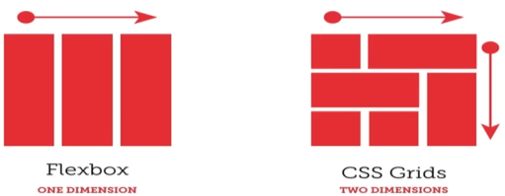
Grid Layout Model
Creating a full-page layout with Flexbox is feasible; however, the task is more appropriately managed with Grid Layout,
Flexbox is better suited for individual components on a page
such as navigation, series of product “cards,” or items intended for alignment in a line
CSS Grid Layout Module offers a system for arranging elements in rows and columns.
Note, Flexbox only organizes elements along a single axis.
Notes:
You can also use a grid to format a portion of a page, like a gallery of images or products

Slide 28
Important CSS Grid terminology
Grid Container: the element on which display: grid is applied. It’s the direct parent of all the grid items.
Grid Item: the children (i.e. direct descendants) of the grid container.
Grid Line: the horizontal and vertical dividing lines of the grid
Grid Cell: it’s a single “unit” of the grid
Grid Track: the space between two adjacent grid lines. which is a generic name for a grid column and a grid row.
Grid Area: it’s a rectangular area made up of one or more adjacent grid cells

Slide 29
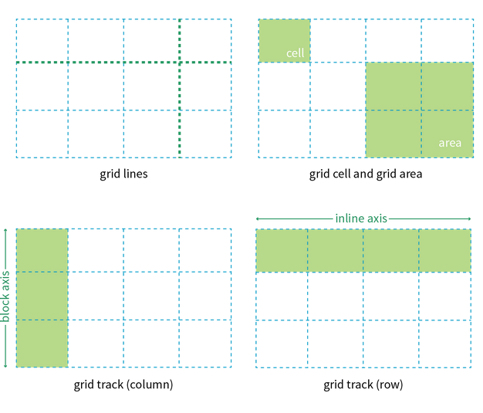
The parts of a CSS grid

Slide 30
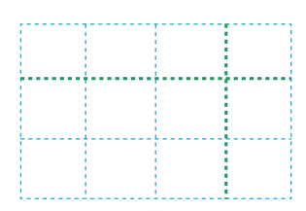
Takeaway question
Can you differentiate between key components in CSS Grid such as
the Grid Container,
Grid Item,
Grid Line,
Grid Cell,
Grid Track, and
Grid Area

Slide 31
CSS grid layout has the following features:
Fixed and/or flexible track sizes
Ability to position items precisely using line numbers, names, or by targeting a grid area
Flexibility to add rows and columns as needed
Control over item alignment within a grid area and the overall alignment of the entire grid

Slide 32
Grid Container
The first step to start using Grid is to create a grid container.
This is done by specifying a container element as a grid through "display: grid"
Followed by specifying ,
how many rows and columns we want and
how wide they should be
Subsequently, positioning the child elements within the grid

Slide 33
Defining Grid track
grid-template-columns and grid-template-rows define the columns and rows of a grid with a space-separated list of values.
The list values represent the track size and the number of values determines the number of rows or columns.
grid-template-rows, grid-template-columns
Values: none | list of track sizes and optional line names
Default: none
Applies to: grid containers
Inherits: no

Slide 34
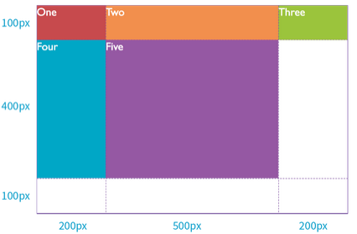
Example
#layout {
display: grid;
grid-template-rows: 100px 400px 100px;
grid-template-columns: 200px 500px 200px;
}

Slide 35
Takeaway question
What is the initial step to take to use CSS Grid?
How do grid-template-columns and grid-template-rows in CSS help define a grid layout?
How do we determine the number of rows and columns in the grid?
Write a CSS code snippet for a grid container with three columns, each equal to 50 pixel, and two rows where the first row is 100 pixels tall, and the second row is twice the height of the first row.

Slide 36
Sizing Grid tracks
In CSS Grid Layout, grid tracks refer to the rows and columns that make up the grid.
It’s possible to specify the size of these tracks using various units and values using,
Flexible Sizes with Fractional Units
Minmax Function
Repeating track sizes

Slide 37
Fractional units (fr)
The Grid specific fractional unit (fr) allows us to create track widths that expand and contract depending on available space.
The fr unit represents a fraction of the available space.
Example,
.container {
display: grid;
grid-template-rows: 1fr 2fr;
grid-template-columns: 1fr 2fr; }
Both rows and columns are set to take up one part and two parts of the available space, respectively.

Slide 38
Takeaway questions
What do grid tracks refer to? and list the different methods to specify their sizes
Create a CSS Grid with three columns, where the first column is twice as wide as the other two.
Create a CSS Grid layout with four columns. Set the first and last columns to be three times wider than the middle two columns.
Create a CSS Grid with five columns, where the first and last columns are half the width of the middle three columns.

Slide 39
Minimum and maximum size range
It is possible to restrict the size range of a track by setting its minimum and maximum widths
The minmax function allows us to specify a size range for grid tracks.
The function takes two arguments: minimum and maximum size
Example,
grid-template-columns: 200px minmax(15em, 45em) 200px;
This rule sets the middle column to a width that is at least 15em but never wider than 45em.
N.B., fr units are not permitted as the minimum value in a minmax() function

Slide 40
Repeating track sizes
In CSS Grid Layout, the repeat function is used when creating a grid with consistent layout without having to list each size individually. Like this,
grid-template-columns: 20px 1fr 20px 1fr 20px 1fr 20px 1fr 20px 1fr;
The pattern “20px 1fr” repeats five times, but it can be written using the repeat function,
grid-template-columns: repeat(5, 20px 1fr);
It takes two arguments: the number of repetitions and the size of each repetition

Slide 41
Takeaway question
What are the two arguments of the repeat function?
Create a CSS Grid layout where the pattern "30px 2fr" repeats three times. (how many columns will it have?)
Create a CSS Grid layout Implement a repeating pattern where the first two columns have a fixed width of 40 pixels, followed by three columns with a flexible width of 1fr, and then repeat this pattern twice.
Notes:
repeat(2, repeat(2, 40px) repeat(3, 1fr));

Slide 42
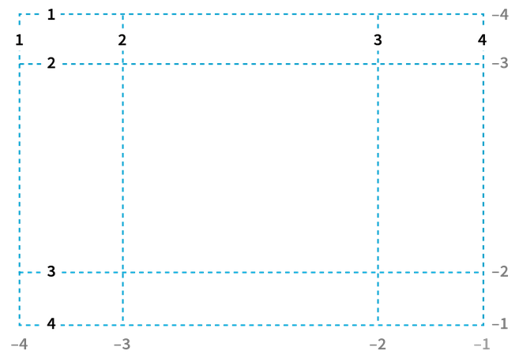
Grid lines and names
When the browser creates a grid, it also automatically assigns each grid line a number that can be referenced when positioning items.
The grid line at the start of the grid track is 1, and lines are numbered sequentially from there.
The lines are numbered from the end of tracks as well, starting with –1, and numbers count back from there

Slide 43
Grid line cont’d
Grid names are user-defined names for lines in the grid.
Grid names are incorporated within square brackets, indicating their position relative to the tracks.
Example,
#layout {
display: grid;
grid-template-rows: [header] 100px [content] 400px [footer] 90px;
grid-template-columns: [ads] 200px [main] 500px [links] 200px;
}

Slide 44
Takeaway questions
How does the browser assign numbers to grid lines, and how does it start?
Can you explain how grid lines are numbered from the end of the grid tracks and how does it start?
What are grid names, and how are they introduced within the grid?
Write a CSS code snippet for a grid container with 2 columns, each equal to 50 pixel, and two rows each equal to 40 pixels.
The grid should have explicit column and row names such as "left," "center," and "right" for columns, and "top" and "bottom" for rows.
Notes:
Counting backward

Slide 45
Positioning grid items
A grid item’s location can be determined by referring to specific grid lines using the following CSS grid properties,
grid-column-start, grid-column-end, grid-row-start, grid-row-end
Values: line | name | span <number> | span <name> | auto;
Default: none
Applies to: grid items
Notes:
<line> – can be a number to refer to a numbered grid line, or a name to refer to a named grid line
span <number> – the item will span across the provided number of grid tracks
span <name> – the item will span across until it hits the next line with the provided name
auto – indicates auto-placement, an automatic span, or a default span of one

Slide 46
Example,
.container {
display: grid;
grid-template-columns: repeat(3, 1fr);
grid-auto-rows: 100px;}
.box1 {
column-start: 1;
column-end: 4;
row-start: 1;
row-end: 3; }
.box2 {
column-start: 1;
row-start: 3;
row-end: 5;}
Notes:
grid-column-start/grid-row-start is the line where the item begins,
grid-column-end/grid-row-end is the line where the item ends.

Slide 47
Takeaway question
Create a CSS Grid layout with three columns and two rows.
Place a grid item in the center column and second row using the necessary properties.
Ensure the item spans two columns and one row.

Slide 48
Gutters
Gutters (or alleys) between grid cells can be created using the column-gap and row-gap properties.
They are properties which specify the size of the grid lines.
Example,
.container {
grid-template-columns: 100px 50px 100px;
grid-template-rows: 80px auto 80px;
column-gap: 10px;
row-gap: 15px;
}

Slide 49
Takeaway question
Create a CSS Grid layout with 10 columns each equal to 20px and three rows each 40px.
Set the gutters 15 pixels wide for columns and 10 pixels high for rows.

Slide 50
Defining grid areas (reading assignment)
In CSS Grid Layout, grid areas allow us to define named areas within the grid and place items into the area by referencing the names.
To define grid areas, we use the grid-template-areas property within the grid container
grid-template-areas
Values: none | series of area names
Default: none
Applies to: grid containers
Inherits: no

Slide 51
Example,
The .container creates a grid with three rows and two columns.
The grid-template-areas property defines named areas for each cell in the grid.
.container {
display: grid;
grid-template-areas:
"header header"
"sidebar main"
"footer footer";
grid-template-rows: 100px 1fr 50px;
grid-template-columns: 200px 1fr; }
Notes:
The example defines areas for a header, sidebar, main content, and footer

Slide 52
CSS Grid Properties
Parent container
Display: grid
Grid-template-rows
Grid-template-columns
Grid-row-gap
Grid-column-gap
Grid-auto-rows
Justify-items: start | end | center | stretch
Align-items: start | end | center | stretch
Justify-content: start | end | center | space-between | space-around
Align-content

Slide 53
Cont.…..
Child properties
grid-column-start
grid-column-end
grid-row-start
grid-row-end
grid-column
grid-row
grid-area
justify-self
align-self
place-self

Slide 54
Additional resource
online games for learning Flexbox and grid
https://flexboxfroggy.com/
https://cssgridgarden.com/

Slide 55
End of chapter four

